Slide 1
Sprint 2

Slide 2
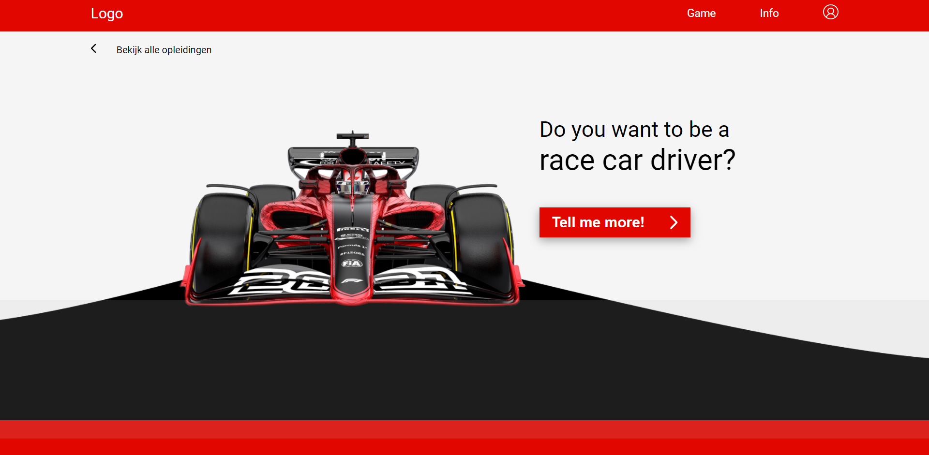
Web

Slide 3
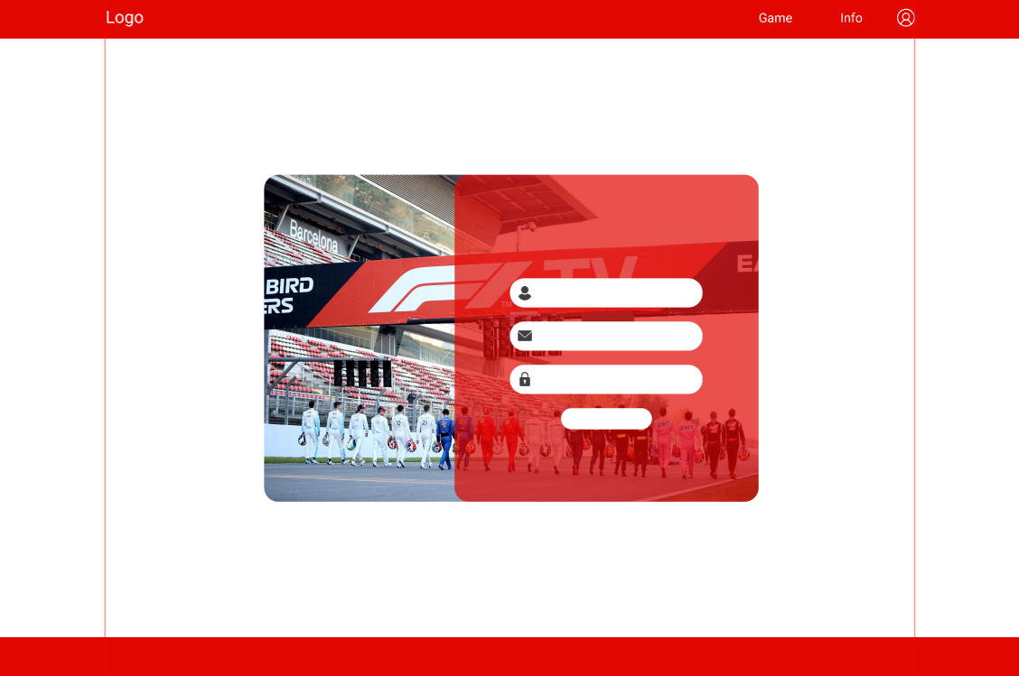

Slide 4
Game

